Slide 1


Slide 2

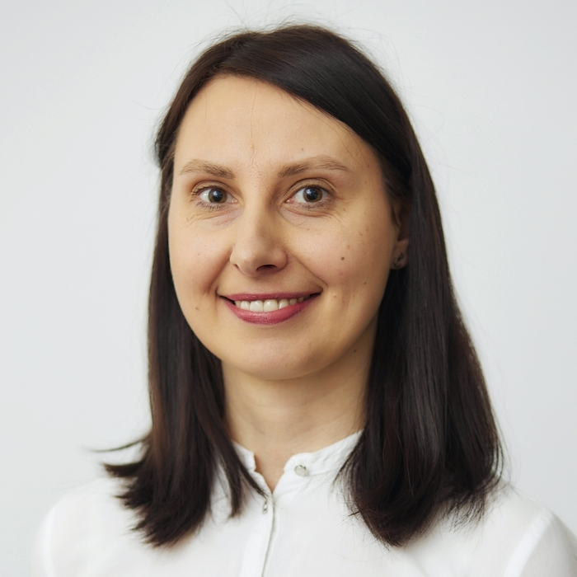
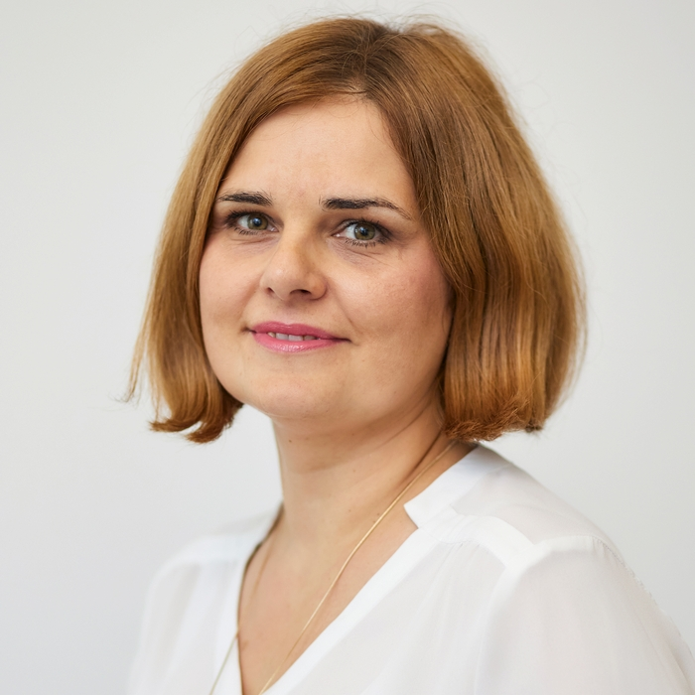
Center for Medical Education in English – Dean’s Office
MANGER
Karolina Andrzejczak, M.A. kandrzejczak@ump.edu.pl
+48 61 854 71 44
VICE-MANAGER
Beata Matyszewska, M.Sc. matyszb@ump.edu.pl
+48 61 854 72 33

Slide 3
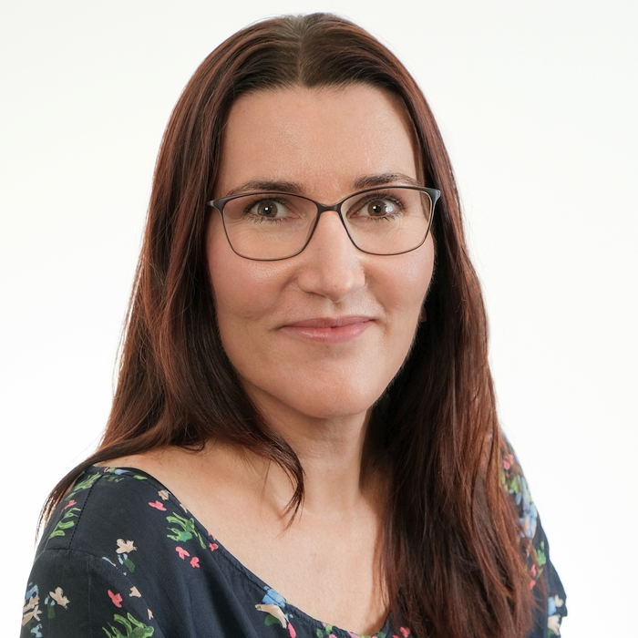
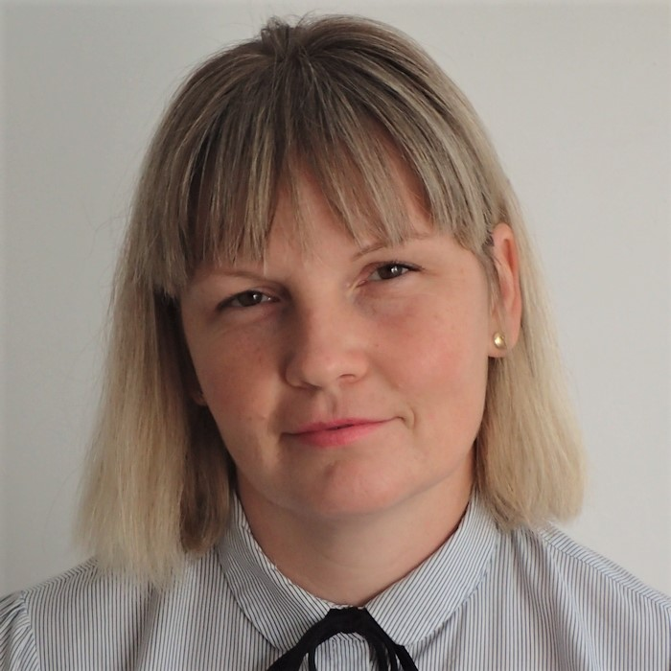
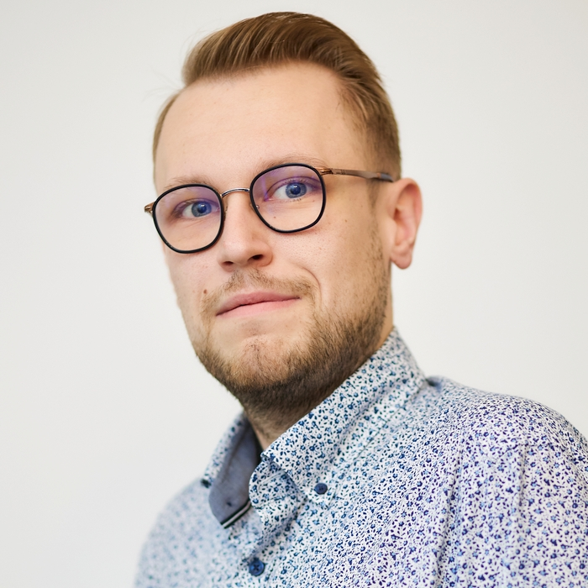
Students’ team
Małgorzata Bojanowska, M.A.
MEDICINE year 1&2 mmargraf@ump.edu.pl
+48 61 854 71 46
Anna Czerwińska, M.Sc. MEDICINE year 3&4 aczerwinska@ump.edu.pl
+48 61 854 72 21
Bartosz Dreger, M.A. MEDICINE years 5&6 bdreger@ump.edu.pl
+48 61 854 71 45

Slide 4
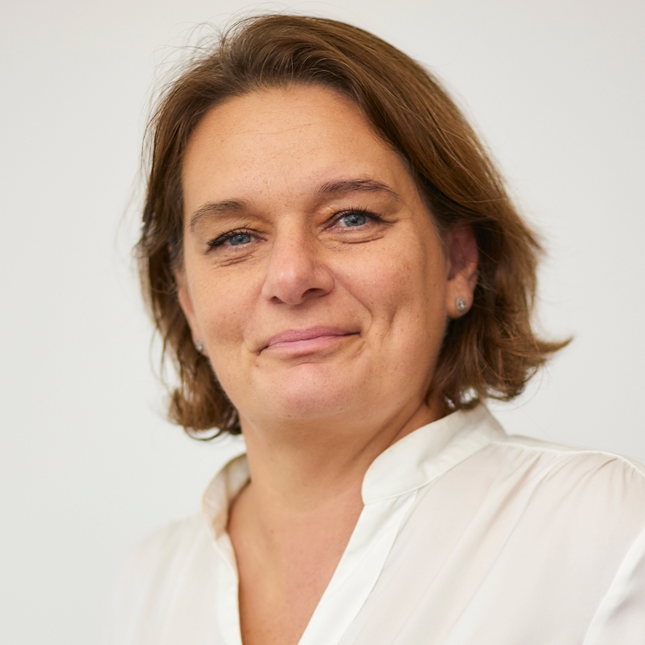
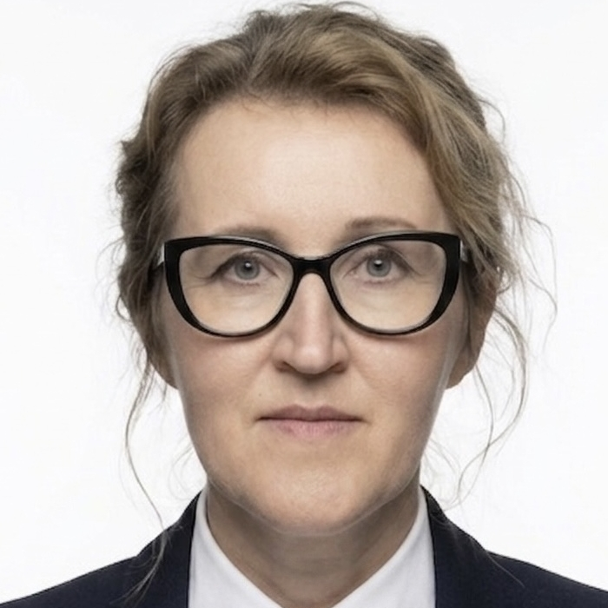
Students’ team
Anna Tomczak, M.A. DENTISTRY year 1 &2 atomczak@ump.edu.pl
+48 61 854 72 24
Anna Grobelna, M.A.
DENTISTRY years 3, 4 & 5 anna.grobelna@ump.edu.pl
+48 61 854 71 35

Slide 5
Students’ team
All students contact us individually to:
  obtain documents (transcript of grades, letter of enrollment, proof of payment – Bursary Office)
  do medical check-ups
  set up doctor’s appointments
  clarify academic matters
Class representatives contact us on:
  issues concerning lab/seminar groups or entire year
  regulations/requirements/academic calendar

Slide 6
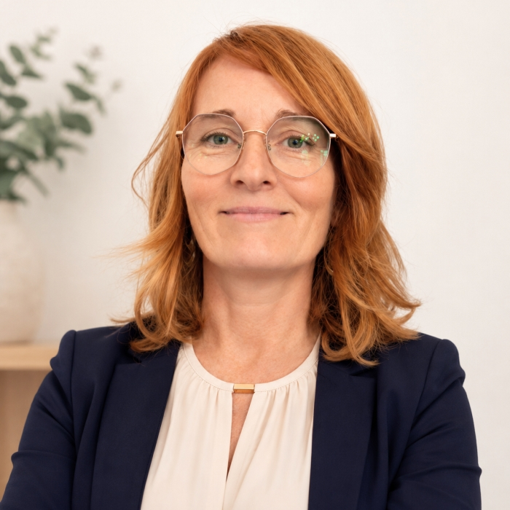
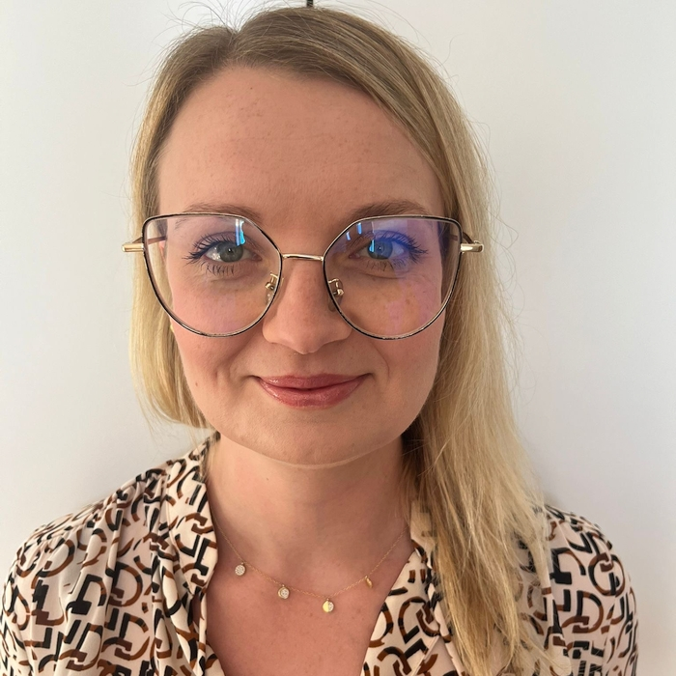
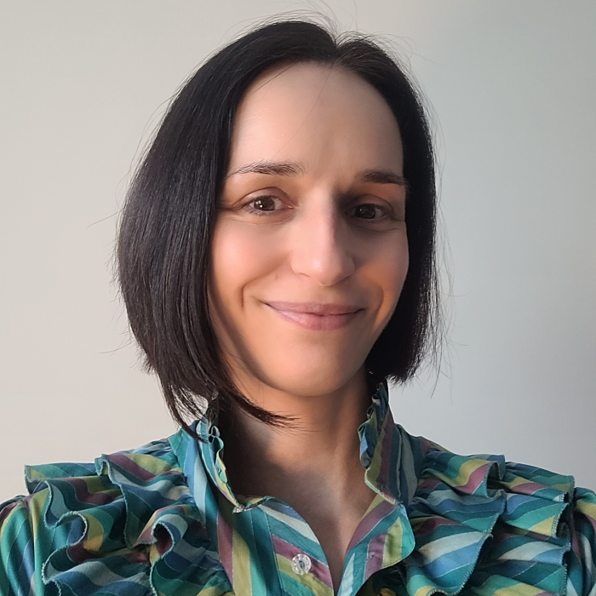
Curriculum team
Matylda Dąbrowska, M.Sc. mdabrowska@ump.edu.pl
+48 61 854 71 43 erasmus.incoming@ump.edu.pl
Daria Fąferek, M.A. daria.faferek@ump.edu.pl
+48 61 854 71 42
Magdalena Przybylska, M.A. STUDENT ORGANIZATIONS
ERASMUS+
magdalena.przybylska@ump.edu.pl, +48 61 854 71 47

Slide 7
Curriculum team
For MEDICINE program :
  setting up exams
  preparing curriculum and schedules
For Erasmus+ students:
  documentation (transcript of grades, letter of enrollment, proof of payment)
  arranging medical check-ups
  setting up doctor’s appointments
  other academic matters

Slide 8
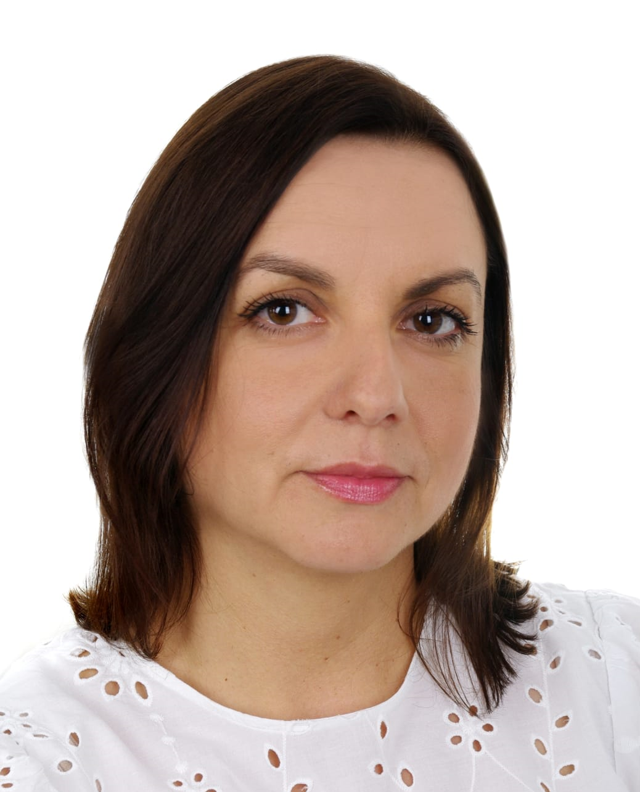
Bursary Office
tuition fees payments
refunds, payment corrections,
EPSU budget
other financial issues
Katarzyna Czarnecka, M.A. kczarnecka@ump.edu.pl
+48 61 854 74 84
Beata Matyszewska, M.Sc. matyszb@ump.edu.pl
+48 61 854 72 33

Slide 9
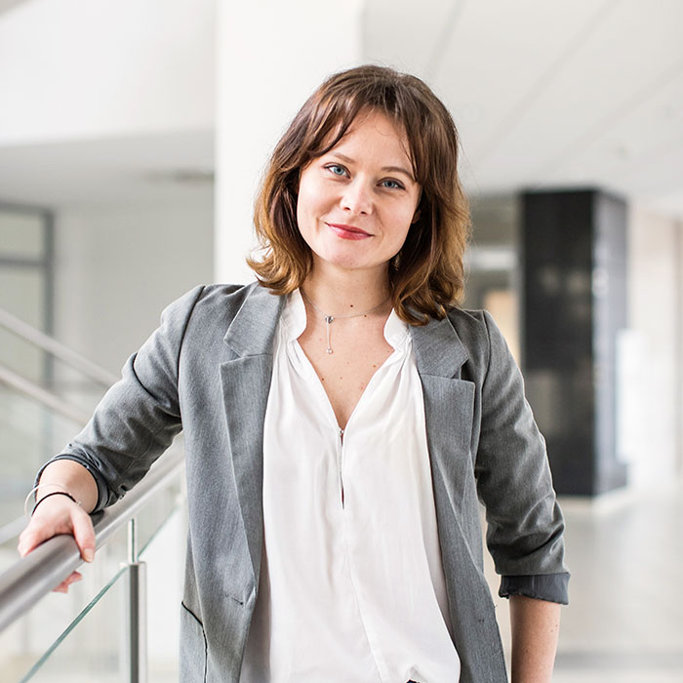
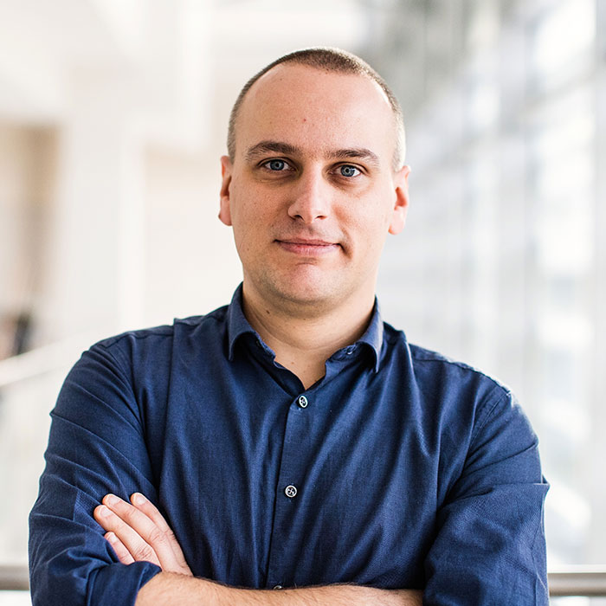
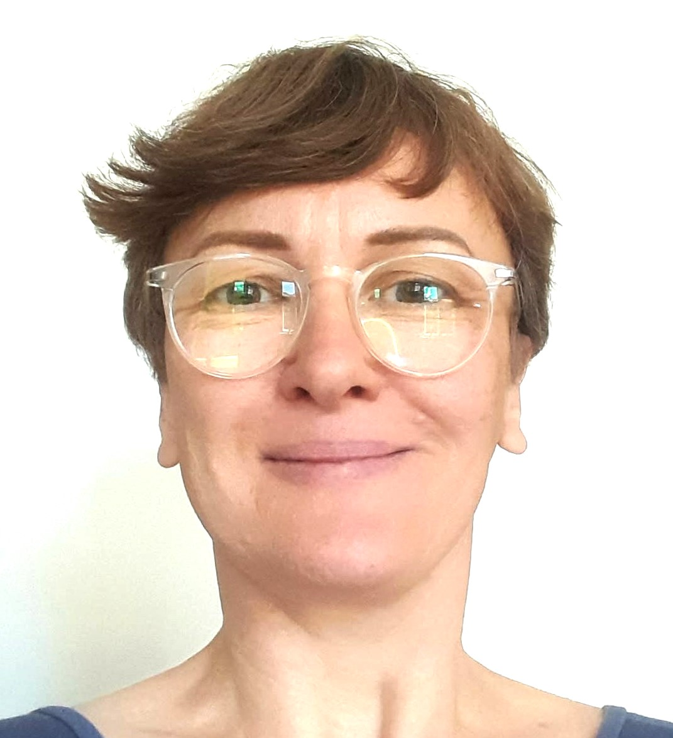
Admissions & Promotion Office
Weronika Maćków, M.A. weronika.mackow@ump.edu.pl
+48 61 854 72 40
Grzegorz Chewusz
chewusz@ump.edu.pl
+48 61 854 72 20
Małgorzata Sikorska, M.A.
malgorzata.sikorska@ump.edu.pl +48 61 854 72 28

Slide 10
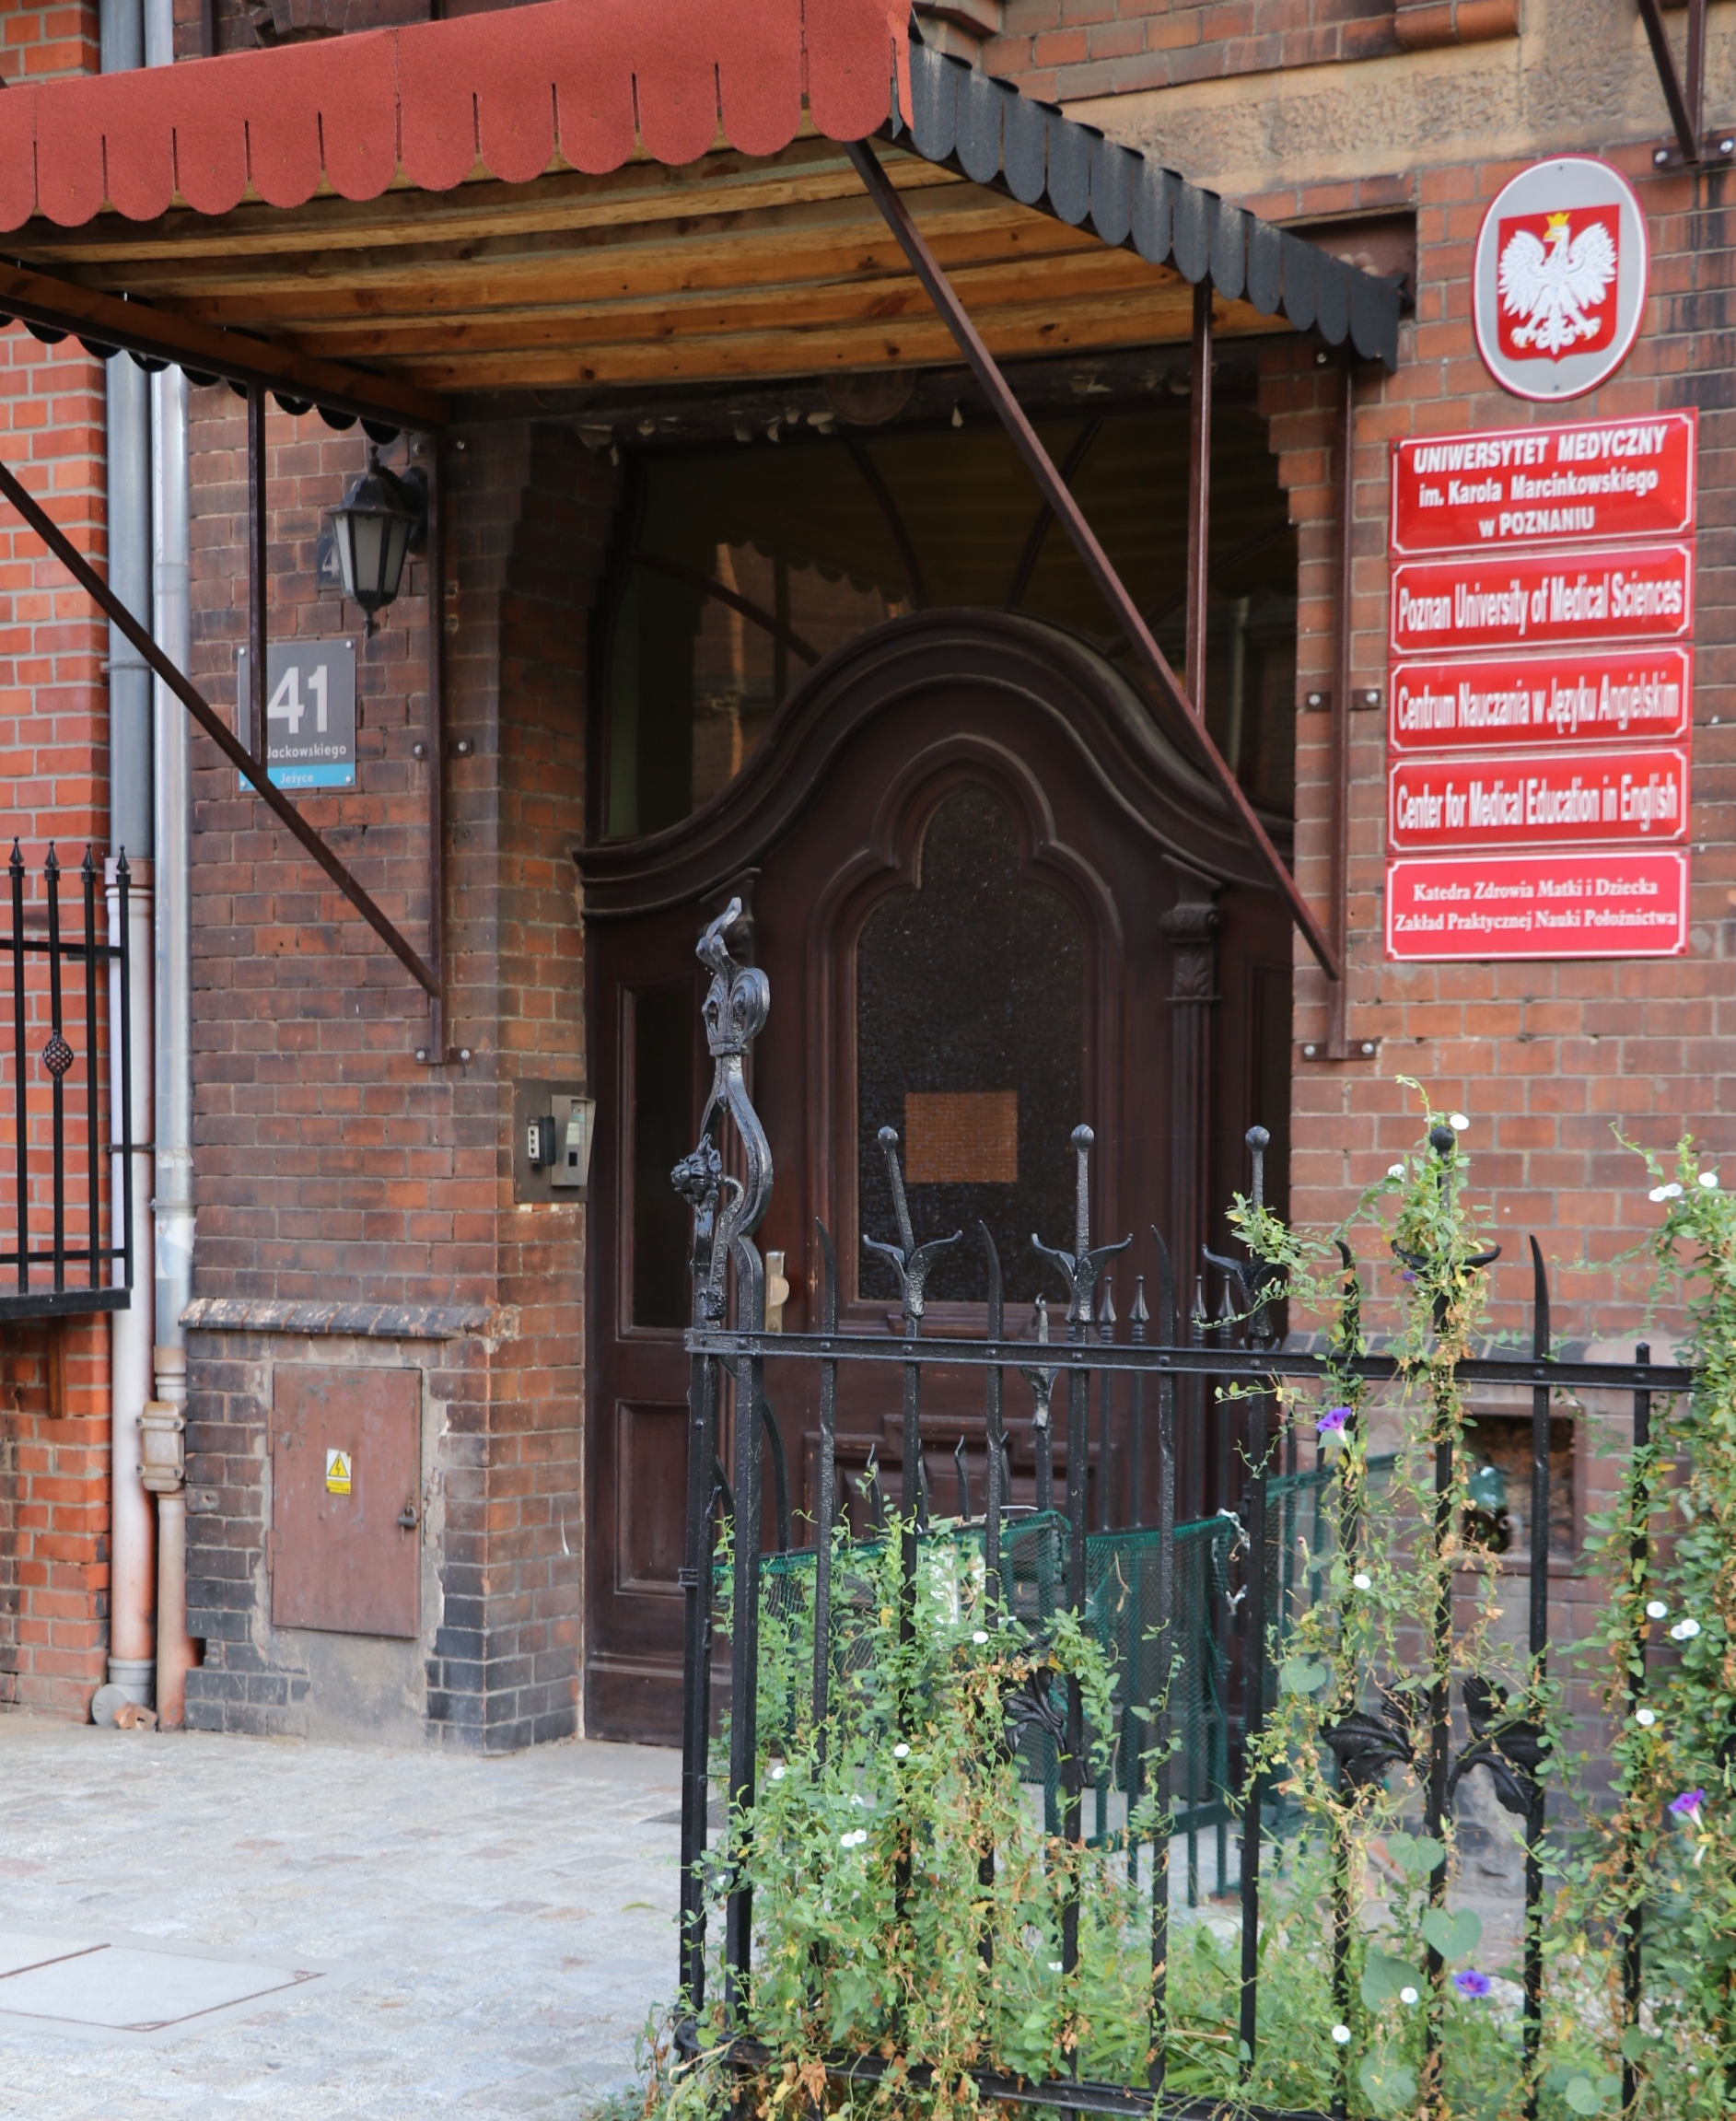
Where can you find us?
Jackowskiego 41 str.
opposite the hospital on Polna str.
We are open from Monday to Friday
Mon and Fri 8.30 am - 1.30 pm
Tue – Thu 10.30 am - 3.00 pm

Slide 11
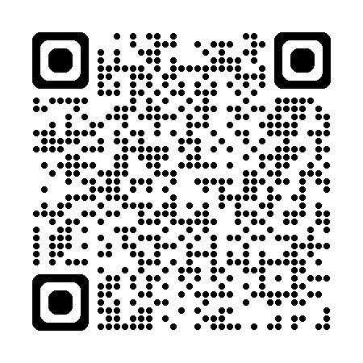
WISUS on-line account
On-line platform with important information:
  student's data (STUDENT UMP),
  payment subaccount information (SIANO),
  grades/credits (AKSON) etc.
Login credentials:
Login: sPERSONALstudentIDnumber
Password: set from a link that was sent to your email

Slide 12

PUMS email
[student ID number]@student.ump.edu.pl
Password: set from a link that was sent to your email
Please make sure to check your student e-mail box on daily basis.
Any contact with the DO, Faculty Authorities and coordinators should be through PUMS mail.

Slide 13



Communication apps
Apps used at PUMS:
  jUMP (easy communication, last minute annoucements, updates)
  MS Teams (online meetings)
  LMS (online classes)

Slide 14
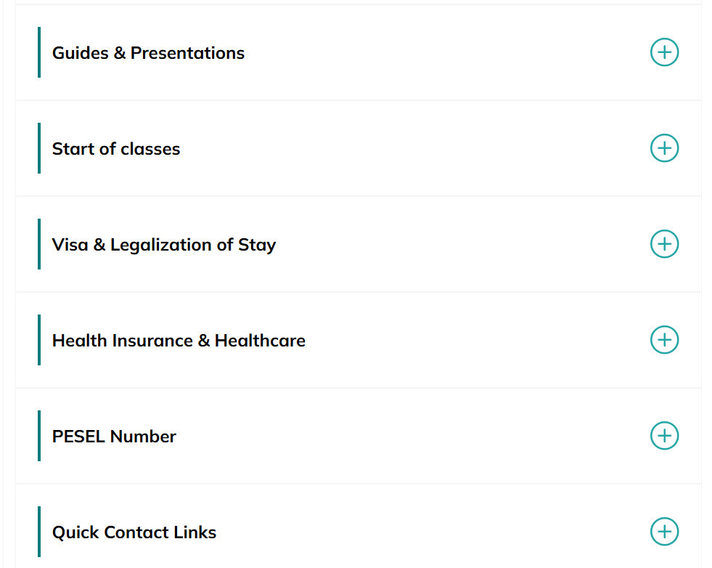

Know your rights!
!
Visit our website for school regulations, current information, PUMS structure and more
STUDENT ZONE
Login: PumsZone
Password: PumsZone

Slide 15
PESEL number + NFZ health insurance
access to Polish government website/NFZ insurance/taxes
all students are required to have valid health insurance
🏥 Healthcare Access – required for registration with the NFZ to use public healthcare services.
💸 Banking and Finance – often needed to open a bank account, sign contracts, or manage financial services.
🏠 Housing Contracts – landlords and dormitories may request PESEL for rental agreements.
🏛️ Administrative Matters – simplifies dealing with Polish offices (e.g., residency registration, tax office, city hall).
📱 Everyday Services – may be needed for mobile phone contracts, internet subscriptions, or insurance.
🎓 University Records – allows universities to register students more efficiently in national education systems.
💸 Reduced Medical Costs
– with NFZ, most medical consultations, treatments, and hospital stays are free of charge or significantly reduced.
🚑 Emergency Coverage
– NFZ covers emergency services, including ambulance transport and urgent hospital treatment.

Slide 16

Student ID card
document that proves you are a student at PUMS
its validity must be extended twice during the academic year (by the end of October and March)
it's necessary to get access to exam room, dormitories, clinical hospitals, etc.
it must be shown to obtain public transport (and other) discounts for students under 26

Slide 17

1st year at PUMS
1st year students must successfully complete Gross Anatomy, Physiology and Histology & Embriology courses and pass exams in these subjects in order to advance to the next year. Conditional entry to the second year without these foundations is not possible.
If you experience difficulties with any course, please do not wait until the end of the semester to seek help. We strongly encourage you to contact the Dean’s Office as soon as you notice challenges.
By reaching out early, we will be able to organize tutoring or other forms of support provided by the Dean, which can make a real difference in your learning and academic success.
To zdjęcie, autor: Nieznany autor, licencja: CC BY-NC

Slide 18

Must do’s:
accept the electronic oath (e-Ślubowanie) in the AKSON system (by September 15)
health insurance (proof to DO by March 31)
visa/temporary stay card for students outside the EU and proof of residence for students from the EU
(proof to DO by March 31)
hepatitis B vaccination (proof to DO by September 30)
PESEL number (proof to DO by November 30)
criminal background report
Polish phone number
setting up bank account in Poland (advisable and helpful)
To zdjęcie, autor: Nieznany autor, licencja: CC BY-NC

Slide 19

Problems? You’re not alone!
English-speaking physicians (set an appointment with Anna Tomczak 61 854 72 24 atomczak@ump.edu.pl)
Free psychological counseling (CAPS)
Dean’s Office (ul. Jackowskiego 41, 1st floor)
Student advisor (dr Andrzej Jawień)
Campus security
Dorm residential advisors (RAs)
HASA (Harassment and Assault Student Advocacy)
Emergency number 112
Disability Office Coll. Stomatologicum Room D132
International Students' Point of Contact - Claudia Dompe Medical Biology Center room 10.58 (ground Floor) Tue-Thu 3-5 pm

Slide 20
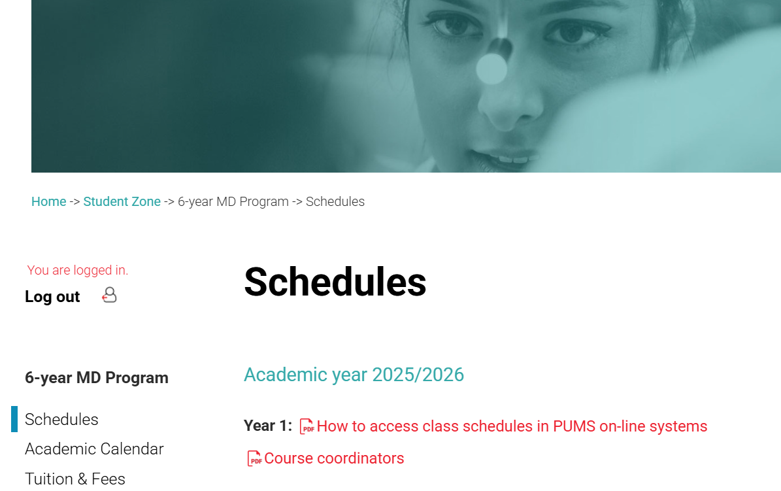

List of course coordinators

Slide 21
Terms of Address –
Quiz for International Students
Q1. How should you address a university professor in an email if you are unsure of their exact title?
A) Hey Smith
B) Dear Professor Smith
C) Hi John
D) Smith
✅ Correct answer: B) Dear Professor Smith

Slide 22
Terms of Address –
Quiz for International Students
Q2. Which is the best way to close a formal email to a professor?
A) Cheers
B) Thanks
C) Best regards / Sincerely + your name
D) No closing needed
✅ Correct answer:
C) Best regards / Sincerely + your name

Slide 23
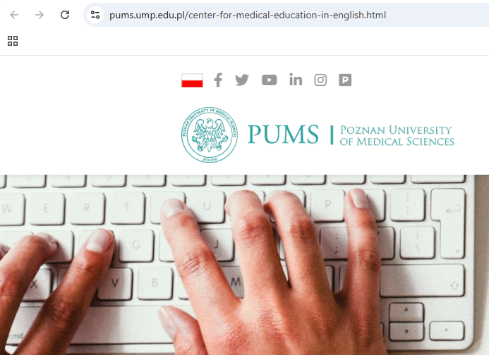

Q3. How do students usually address each other?
A) Always by title and surname
B) Only by student ID number
C) By first name in most situations
D) By last name only
✅ Correct answer: C) By first name in most situations

Slide 24

PUMS online

Slide 25









PUMS on Social Media
instagram.com/pums_poznan​
linkedin.com/school/pumsmed​
tiktok.com/@poznan_medical_uni​​
facebook.com/PUMS.UMP​

Slide 26


Ambassador’s Club
We will start the auditioning soon.
Be ready and look for the infos!
… join our creative team!
Our goal: to make others green with envy over PUMS SoMe channels!

Slide 27

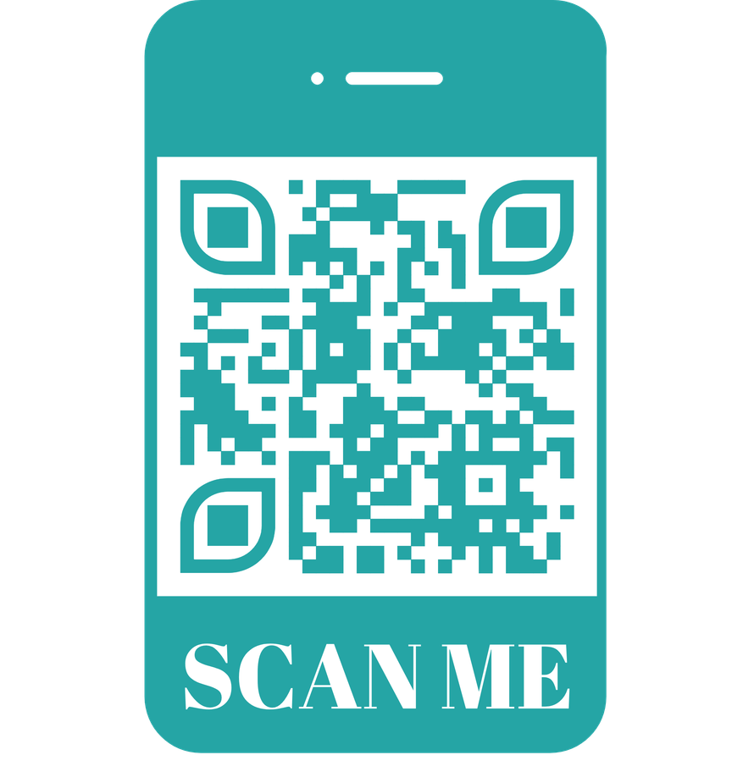
PUMScommunityHUB
Become a member of our PUMScommunityHUB platform.
Connect with alumni,
find a mentor,
get to know the recent news
and many more!
pumscommunity.com

Slide 28

PUMS 1st Alumni Reunion
If your parent are our alumni,
let them know and ask them to contact us at alumni@pums.edu.pl or check our SoMe for announcements!
Much appreciated!
Where:
in New York
When:
in April 2027!

Slide 29
But above all
have the time of your life!!!

Slide 30

THANK YOU

