Slide 1







Legalisation procedure for full time students

Slide 2

Presentation Agenda
1
Introduction
2
Temporary residence permit for non EU full-time students
3
Information for EU students
4
AMU Welcome Center
5
Polish citizenship

Slide 3
Temporary residence permit for non EU full-time students

Slide 4















Temporary residence permit
How & When
No possibility to apply by traditional mail/email/or in person at the WSC office
Applications must be submitted no later than the last day of your legal stay in Poland
Apply only through MOS portal
https://mos.cudzoziemcy.gov.pl/
ONLINE
Scan and attach all documents and photos
Annex No. 5
from university
Sign the application by:
Trusted Profile (Profil Zaufany), a qualified electronic signature
Attach Annex No. 5 signed by authorised person from university
i
*Important: When submitting your application online, you will need to provide your university’s email address so that the university can complete and sign Annex No. 5. Without this, you will not be able to complete and submit your application in the system.
How To Apply

Slide 5







Documents to submit
Application form
biometric PHOTOS
  Annex No. 5 from university
  Valid photo in digital format
photocopy of your passport
documents from university
  Digital image (scan or photo) of all pages of your valid travel document
  Confirmation letter from University with proof of payment of tuition fees
insurance/finances
proof of payment of the stamp duty
  current proof of valid health insurance
  current documents confirming financial resources
  a filled in and signed declaration regarding housing costs
  340 PLN for the application
  with: Proof of payment of the fee for issuing the residence card (50 PLN)

Slide 6

Documents – Further Details
Confirmation letter from university with Proof of payment of the tuition fee
Financial resources
  1010PLN per month (823zł *family members), after deducting cost of housing, with reference to the period of studies
188 718
  200/2500 PLN for
  the flight ticket
  confirming the payment of tuition fees in a given semester/academic year
Health Insurance
Housing costs
  Contract with NFZ (National Health System)
  proof of payments
  The cost of living includes: Lease, Utilities, including: energy, gas, water, sewage, waste
80%
  Private health insurance that covers all medical expenses in Poland
  If you change a place of residence, the office must be informed about it and a new declaration of the cost of residence must be submitted

Slide 7

Duration of the residence permit
The first permit (the first year of first / second cycle studies) is granted for a period of:
The next permit (the subsequent year of study) is granted for a period of:
01
02
15 months for the duration of the academic year or studies extended by 3 months - if the study period is shorter than 15 months
The duration of studies extended by 3 months, but no longer than 3 years
2 years if the studies are covered by the EU program etc.
PHD students: The duration of studies extended by 6 months, but no longer than 3 years
PHD STUDENTS!
2 YEARS & 6 months

Slide 8







Residence card
The procedure terminates with an administrative decision
Confirmation of registered residence or Statement about the residence card printout without an address
Residence
card
01
02
Proof of payment for the card (when applying for residence permit)
The residence card is to be collected in person only (after 2-4 weeks time)

Slide 9

Payment for the temporary residence permit 340zł
Urząd Miasta Poznania Wydział Finansowy
Oddział Pozostałych Dochodów Podatkowych i Niepodatkowych,
61-706 Poznań, ul. Libelta 16/20; PKO BP S.A.
Bank account number:
94 1020 4027 0000 1602 1262 0763
1
Bank account numbers
https://migrant.poznan.uw.gov.pl/en/wskazowki/feesstamp-duty
Payment for the temporary residence card 50zł
Wielkopolski Urząd Wojewódzki,
al. Niepodległości 16/18 Poznań,
Bank account number:
70101014690000392231000000
2

Slide 10







Important matters
Check the status of your case on our website on a regular basis
schedule an appointment for attendance, fingerprinting and passport presentation via the case status tracking page
All the documents are to be submitted in Polish or with official translation into Polish
Originals of all documents must be presented or submitted at the office
1
2
3
4
https://www.poznan.uw.gov.pl/cudzoziemcy-stan/?lang=en

Slide 11


How to recognize a
dishonest representative?
s/he promises to speed up the procedure because of connections?
Are you sure your representative is following the regulations?
s/he persuades that s/he will arrange an appointment “without a queue”?
Are you certain that your
representative is acting in your best interests?
s/he claims there is a “faster” way to get a residence card?
Do not be deceived!
Do it yourself

Slide 12















5 steps
Choose date for personal appearnce
Document verification
visit + documents
decision
+ residence card

Slide 13
Legalisation Procedure
EU citizens + Switzerland and Norway

Slide 14

01
Application form
02
4 biometric photographs
EU Students
03
Health insurance
- European Insurance Card (EKUZ in Polish)
04
Proof letter from University in Polish
Registration of residence
https://migrant.poznan.uw.gov.pl/en/node/1506
05
Passport or national ID
06
Statement confirming the source of income

Slide 15






Take an active part in the proceedings
Apply during your legal stay in Poland
Write your email address correctly in the application form
Send your application by mail or
Submit your application at the Department for Foreigners in Poznań
Schedule an appointment for attendance and passport presentation via the case status tracking page
Make sure that your application is fully completed, signed, and accompanied by the necessary attachments e
Check the status of your case regularly

Slide 16


Amu Welcome Center
FOR STUDENTS ONLY
get information regarding residence permit procedures
get help in filling out application forms regarding residence permit/EU registration/with MOS
submit necessary attachments (without attendance, fingerprinting!)
Immigration Consulting Point at AMU WELCOME CENTER
Opening hours: every Wednesday from 8.00 am till 4 pm
Location: AMU Welcome Center, Święty Marcin 78 Street /corner of Kościuszki Street (groundfloor), Poznan

Slide 17



01
application for confirmation of Polish citizenship
02
copy of the applicant’s valid foreign passport
Polish Citizenship
03
birth certificate showing the applicant’s personal details and the details of their parents
document confirming the Polish citizenship of one of the parents, e.g. a Polish passport, Polish identity card or certificate confirming Polish citizenship;
04
Confirmation of Polish Citizenship
Department of Civil Affairs
Customer Service Point for Polish Citizenship Matters,
al. Niepodległości 16/18, Poznań
Information : +48 61 854 10 32
(Mon-Fri: 8:30 a.m. – 10:00 a.m.)
e-mail: so@poznan.uw.gov.pl
05
documents confirming any changes to the applicant’s personal details, if applicable;
06
if there are discrepancies in personal data, a written explanation of the reasons for such discrepancies
administrative fee: 277 PLN
No confirmation of Polish citizenship?
You can also apply for permanent residence
based on Polish origin! More information here: https://migrant.poznan.uw.gov.pl/en/procedury/i-am-polish-origin

Slide 18

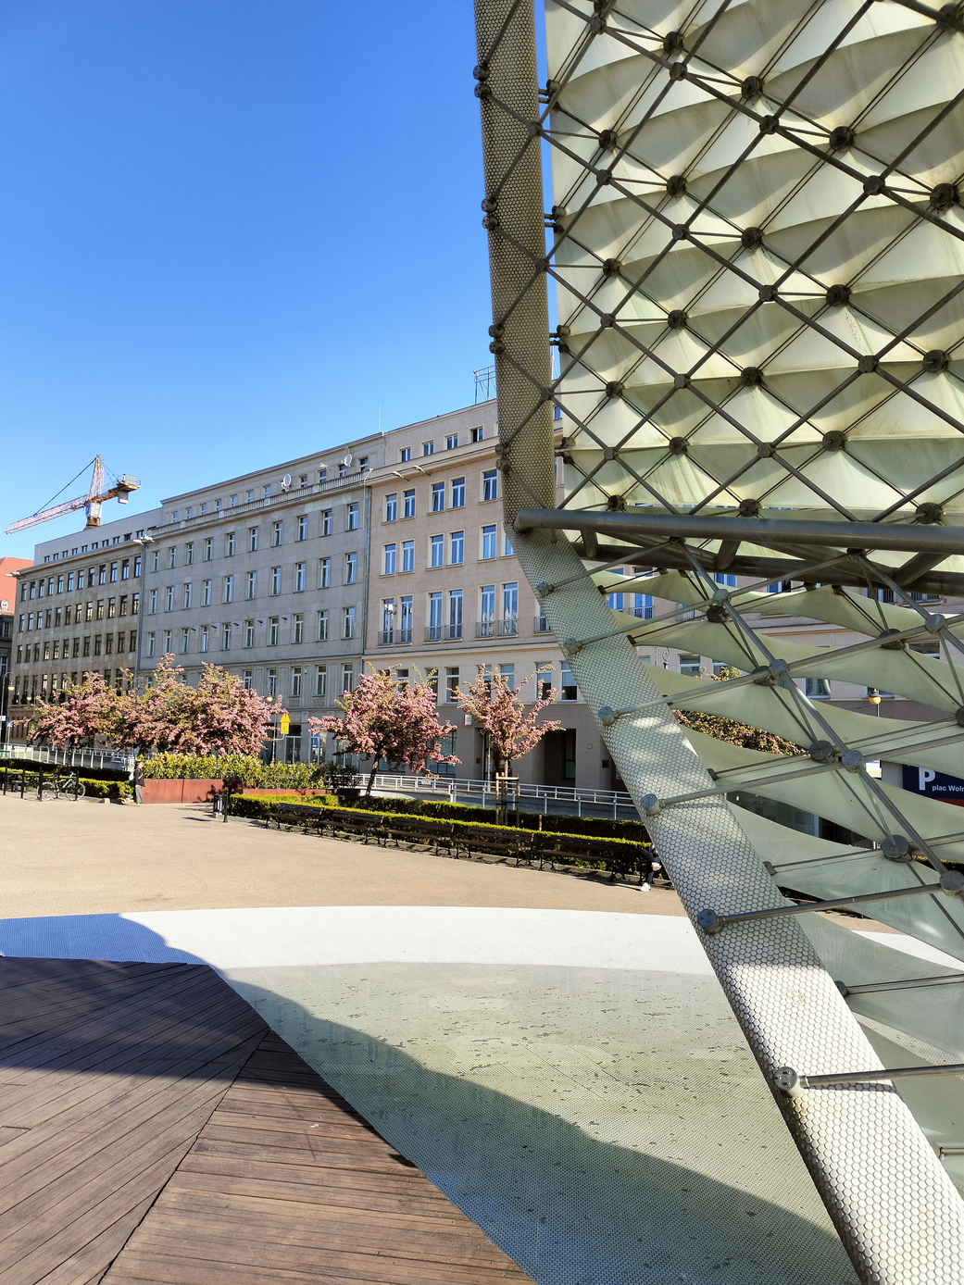
Plac Wolności 17, 61-739 Poznań
Information: +48 61 850 87 77
Website: www.migrant.poznan.uw.gov.pl
WSC CONTACT portal
Submittion Point hours:
Mon-Fri 8:15am - 3:15pm
Information Point hours:
Mon: 10:30am - 6:00pm
Tue-Fri: 8:15-3:15pm
Office hours:
Mon: 9:30-6:00pm
Tue-Fri: 8:15-3:15pm
AMU Welcome Center
Immigration Consulting Point at
(Św. Marcin 78 Street,Poznań):
Wed: 8:00am-4:00pm

Slide 19
thank you

